Slide 1
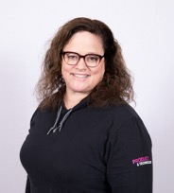
BACKGROUND
Jennifer Stockton
4 years at T-Mobile
Recruiting
Chris Hill
2.5 years at T-Mobile
Platform Engineering
Notes:
Jen and Chris Slide
This is a build slide in that it will do the left side first with Jennifer’s info showing, she introduces herself, then after a transition –it will show Chris’s picture and side for him to introduce himself.

Slide 2

Pursuing Unicorns
Notes:
In 2020 Chris came to talk to you about T-Mobile’s pursuit of becoming a unicorn. In that talk there was a statement that we were in a conversation and process of determining large scale directional movements in people, process and tools in our transformation journey which was/is 100% accurate.

Slide 3
We needed to change
Notes:
We had been taking a hard look at our development practices: We knew a few things needed to change, we had a "tell and control" command culture. Our team felt a lack of empowerment and engagement, we had increased turnover of development staff, team members were asked to perform work with limited context and little control over priorities. Chris talked a little about this "chaos" in his last chat that contributed to this.
In this introspective look at our team we embarked on a transformation journey with people at the heart of the change.
And we ultimately we decided to

Slide 4

Let's bring development in house
Notes:
Our internal team composition was over indexed on consultant level and project management talent. Most of our development was being done by a contract workforce.
We realized that it’s much easier to invest in your own company’s technical future and culture when they are your employees rather than someone else’s.
Another big downside of this is that when a “project ends” the knowledge disperses into the abyss unless there is a new project spun up. Knowledge in and knowledge out the door
HJ

Slide 5
Just post some ads and start interviewing, right?
Notes:
To be able to bring development in house we would need to do two things in order to meet hiring demands so we could replace our contract workforce:
Recruiting would have to scale to meet the demand
We needed to ensure we had the right decisioning process for hiring talent.
T-Mobile invested in both. Our recruiting team and our P&T leadership team, along with some key development staff got in a room and started to create a system that would speak to development resources. Speak to the value of coming to T-Mobile to be part of our transformation process.
How do you create an interview process that enables hiring the best developers?

Slide 6

Developers hire the best developers
Notes:
6Min
No one speaks your language like a developer does. Prior to this change our interview processes were extended, multiple loops, long, didn't put you as a candidate first, the cycle was drawn out and we needed to be more competitive.
Bring forward the best of what T-Mobile had to offer.
So our development team met and were on a discovery mission to not only define what development looked like at T-Mobile but what it meant to be proud of where you work?

Slide 7
We are building a developer community.
Notes:
Our teams know they are transforming, they are committed and dedicated to getting the work done and development is a place where work gets done. We needed team members that could come in and make T-Mobile that better place. T-Mobile has a Development community, deveolper relations.
Dedicated Learning Days, Developer Community,
T-Mobile Devops Days: Two hour segment in how they transform, security, deployment focused, etc. Idea box, inner source/open source, that contributed to a good culture
We also have incredible DE&I in various groups that added to the way we connect.
We knew that change was moving in a positive direction
So we needed to set the expectations from the beginning that development is important and that you wanted to come join the team. But how do we get them to the table?

Slide 8
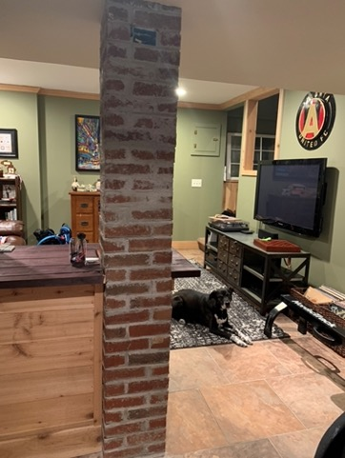
Notes:
my face looked like this...

Slide 9

Notes:
brought us this recruitment product. Now go run with it.
Let's bring in the people.

Slide 10
React Developer Opportunity!!
I hope you are well today. I came across your profile and believe you'd be a great fit for a position in Atlanta, GA. Exciting new role with an AWESOME client seeking a React Developer for a contract to hire position joining their growing team at an amazing consulting firm! They are seeking experience with the following:
Notes:
11min
It was a disconnected experience between the front door and the back room. We needed to be confident that if we reached out to this development community we didn't make all the mistakes of the recruiters that came before us, that in some cases were us!
You all know what I mean, you have gotten those LinkedIn messages.
Our development team taught us, the partnership we formed with our team talked to my recruiting team about what they need to hear, how we need to position our value.
Half way through the year last year I called Chris and said hey......
Once we started interviewing, we successful due to this partnership.

Slide 11
RESULTS
“Our new candidates have the right attitude on their first day in part because of Workforce Transformation. They are able to immediate start to create value for T-Mobile immediately after the recruitment process. ”
Notes:
13 min
Launched in March of 2020
Over 750 interviews
Hired over 267 Software Engineers
That is about 67% more than we did in 2019, and about 85% more than in 2018.
2021 SWE
500 hire target
Attrition
<7% attrition rate target

Slide 12
Happiness is direct correlation with performance.¹
To be a developer at T-Mobile was not a great experience.
¹ The SPACE of developer productivity (https://queue.acm.org/detail.cfm?id=3454124)
Notes:
Chris Slide
Well assuming after the recruitment process, we have happy new hires, how do we keep them happy?
Happiness is...
It was obvious to us from the beginning there was some improvement needed, and that being a developer at T-Mobile not a great experience.

Slide 13
Let’s just improve the experience?
Larger bean bags? Pinball machines?
Notes:
There are many dimensions to happiness and fulfillment.
This reminds me of an ongoing argument between my wife and I on who gets to do some specific chores. Pressure Washing the drive, painting, carpet shampoo-ing and I couldn’t figure out why these particular tasks are contentious for us…
Until finally I discovered it’s because fulfillment was missing from our day jobs. The fulfillment felt by doing these tasks are immediate and satisfying.
So… we need to improve the experience and we need to increase the capability to obtain fulfillment. Other wise we are directly responsible for pristinely clean driveways across the US.

Slide 14
What makes up the developer experience?
Notes:
Like most technology positions today, systems are our companions to delivering value to our company.
In the same way that a cashier relies on their POS system, a developer relies on their tool chain or path to production systems to deliver values to their customers.
What kind of systems are you talking about?
VPN Active Directory E-mail Server Keycard scanner (when we’re in the office)
While those seem to be common forgotten because they should just work – I’m more referring to the tools which help shlep your work into production.
Application Lifecycle Management Tools Source Control Repositories Artifact storage IDEs CI/CD System Docker Registry Maven Registry
If you look up how many companies manufacture systems like this, the permutations are endless.
xebialabs

Slide 15
Do I need to change the systems?
Notes:
Ok, we need to swap out old bad systems and replace them with best from an experience standpoint.
Let’s just find the best tool for the job and give our developers what they deserve, only the best!
Ok, let’s say we do this…

Slide 16
Remember Conway’s law ?
https://en.wikipedia.org/wiki/Conway%27s_law
Notes:
This told us our software arch will equal our people/comminutions org arch.
We discovered process architecture which heavily relies upon your selection of systems/tools will also end up as your communication structures as well.
Best of breed of your tool selection DOES not equal best of breed of flow.

Slide 17
Flow
https://en.wikipedia.org/wiki/Conway%27s_law
Notes:
22 min
Should you pick a different company for every companion system a developer uses, you’ve obligated them to memorize the how and the why of the narrative of each tool. This can be expensive.
I’m not actually talking about in dollars.
Let’s set aside that the authors of the systems may actively be trying to eat their neighbors lunches, and let’s just focus on the user impact.
I’m talking about cognitive load.

Slide 18
Cognitive Load ¹ Budget
“amount of information that working memory can hold at one time.”
¹ Cognitive Science https://onlinelibrary.wiley.com/doi/abs/10.1207/s15516709cog1202_4
Notes:
How many of our enterprises are actively trying to decrease cognitive load placed on employees of all companion systems required to do their job? IMHO, it’s a zero sum game, you can’t keep adding more systems and expect cognitive load capacity to just increase.
There is a budget of how much memory your brain can keep volatile, and I’m personally due for a RAM upgrade here in the next couple of weeks.

Slide 19
Yes. Change the system.
Notes:
I don’t see cognitive load going down enough – nor do I see it being tracked on an ongoing basis.
I specifically didn't include the other cognitive load vampires like time sheet systems, HR systems, portfolio systems, spreadsheet systems (macros anyone)?
So to answer my previous question, do I need to change the system? Yes, you have to change the systems, but you may need to change the system of systems.

Slide 20
“you are either building a software business
or losing to someone who is”
– Andrew Shafer [Velocity NYC]
Notes:
Let’s be honest here, it’s not all rainbows and unicorns. It’s about continuous improvement for you to fight for what’s right.

Slide 21
LESSONS LEARNED
Is a team positioned to transition to taking on development?
Is a team positioned for virtual/async engagement?
Multiple hires for the same team create more synergy than single hires.
Treat cognitive load like a budget
System of Systems lends itself to throughput focus.
There is no talent shortage, but there are bad experiences
Notes:
26 min
Chris and Jen Slide
Focus on Throughput not best of breed.
Decentralize Centralization
Treat Cognitive Load like a budget
Focus on experience and happiness

Slide 22
WHAT WE NEED HELP WITH
Approaches to senior level recruiting
Improve disparity between technology and recruitment
How have you improved your feedback loop within dev relations?
How are you measuring cognitive load?
Notes:
28min
Jen and Chris Slide
How have you captured the feedback for how new recruits and existing recruits.

Slide 23
THANK YOU
Notes:
30 min

Slide 24
Notes:
Closing Slide (Chris Slide)
You’ve got to change the system first, everything thinks it’s a talent problem – how can I hire people, how can I onboard – you’re side-stepping your real problem – your system. What does it take to change the system to get the talent that you want.
What if the system itself will draw in people.
Talent is about changing the system.
“Don’t go to T-Mobile, I had a friend that went there.”
Intrinsic and Extrinsic motivation – you have to figure out that are not that kind of people that wake up, that aren’t the people that speak at DOES, right environment. The change agents are the extrinsicly motivated people, you have to pay them what their worth, but they are going to come in.
How do you bring in the talent with legacy systems that are weighing in. How can we turn this into clouds and rainbows –
Here’s what I learned about managing complex systems. You have to understand the consistent patterns. Good times, it happens quicker – quicker feedback loops, same patterns no matter where you get.
Have you change the system
Still have to do rebellions /skunkworks.
Lessons learned.
Anti Powerpoint
Chris Corion – Cnefin and Wardly Mapping Complicated
“have you change the system”
Tips and tricks in great teams on where it’s very difficult.
Rework
I’m a fighter, we knew what was working, the pandemic was anaomoly that got thrown at us. How hard is it, I need to have a pattern that works in optimal scenarios and sub-optimal scenarios. I try and draw on the things I know that are true. Let me show you some successful patterns and when it’s more difficult. The guy who runs complex development teams and the reality check on how hard it is. What do you have to do to change the system. Slowly degrade the systems that are in our way...
A lot of the presentations are hey we hit the pixy dust and it worked and it was awesome – it’s being transparent about how hard it was an complex.
Andrew Cliché – there is no talent shortage.
The more you pile on similar but different auth narritives.
Now you might have the
It’s even worse than Conway’s law in your product architecture stacks because now you have corporate initiatives specifically designed to control the developer flow narrative. Quality of life and a native experience now could come at a cost - Imagine your POS system is actively trying to impede you just enough to pay for the POS+ service which will make your life easier.
Understanding each of the narratives associated with your systems is additional cognitive load.
-----
We have a lot of improvement to make, but to date, we’ve hired - This is a work is progress, we've hired 220 people out of 500 remaining. We've learned quite a bit and still have a lot of learning to do.
Where are we.....
Getting them in the door isn't enough?

Slide 25
Notes:
Closing Slide (Chris Slide)
You’ve got to change the system first, everything thinks it’s a talent problem – how can I hire people, how can I onboard – you’re side-stepping your real problem – your system. What does it take to change the system to get the talent that you want.
What if the system itself will draw in people.
Talent is about changing the system.
“Don’t go to T-Mobile, I had a friend that went there.”
Intrinsic and Extrinsic motivation – you have to figure out that are not that kind of people that wake up, that aren’t the people that speak at DOES, right environment. The change agents are the extrinsicly motivated people, you have to pay them what their worth, but they are going to come in.
How do you bring in the talent with legacy systems that are weighing in. How can we turn this into clouds and rainbows –
Here’s what I learned about managing complex systems. You have to understand the consistent patterns. Good times, it happens quicker – quicker feedback loops, same patterns no matter where you get.
Have you change the system
Still have to do rebellions /skunkworks.
Lessons learned.
Anti Powerpoint
Chris Corion – Cnefin and Wardly Mapping Complicated
“have you change the system”
Tips and tricks in great teams on where it’s very difficult.
Rework
I’m a fighter, we knew what was working, the pandemic was anaomoly that got thrown at us. How hard is it, I need to have a pattern that works in optimal scenarios and sub-optimal scenarios. I try and draw on the things I know that are true. Let me show you some successful patterns and when it’s more difficult. The guy who runs complex development teams and the reality check on how hard it is. What do you have to do to change the system. Slowly degrade the systems that are in our way...
A lot of the presentations are hey we hit the pixy dust and it worked and it was awesome – it’s being transparent about how hard it was an complex.
Andrew Cliché – there is no talent shortage.
The more you pile on similar but different auth narritives.
Now you might have the
It’s even worse than Conway’s law in your product architecture stacks because now you have corporate initiatives specifically designed to control the developer flow narrative. Quality of life and a native experience now could come at a cost - Imagine your POS system is actively trying to impede you just enough to pay for the POS+ service which will make your life easier.
Understanding each of the narratives associated with your systems is additional cognitive load.
-----
We have a lot of improvement to make, but to date, we’ve hired - This is a work is progress, we've hired 220 people out of 500 remaining. We've learned quite a bit and still have a lot of learning to do.
Where are we.....
Getting them in the door isn't enough?

Slide 26
AGENDA
Status of pursuit
What we noticed – Workforce (people)
Impact
How to solve
What we noticed – Systems engagement (tools)
Impact
How to solve
Lessons Learned
What we need help with
Notes:
Jen Slide
T-Mobile working on their culture to bring in engineers. Not only how did we do it, but where we hit success in it.
Managers where we’ve brought through the engineers that allows the developers to chat with them and talk with them, understand how they code. Putting them first on the driver seat.
Expect y number of engineers to hire, we hired x engineers, we’re slated to do 500. Our hiring culture hired engineers that were hire level in their career. Setting up process and procedure to evaluate the talent for their coding ability. They have to own the development.

Slide 27
APPENDIX

Slide 28
IMPACT
Developer boredom
High coordination costs
Low fulfillment
Lack of engagement
Notes:
Single-Use – High tolerance for clunkiness
Every-day-use – Low tolerance for clunkiness
Halfway in between (dreaded timesheet system every other week)
Cognitive load is massive and the context switch is a contributing factor for burn out.
“How can I get to do dev work, when I’m just hit in excel spreadsheet” – my devs are build because tall they do are code reviews.

Slide 29
HOW TO SOLVE
Building for empowerment
Decrease cognitive load
Measure performance as multi-dimensional
Decrease fragmentation of process and tool narritives
Notes:
Chris Slide
Cognitive Load budget
If you’re platform is ultimately successful, it’s the platform or service which is talked about the least.
How do you measure the system you build in the context of being a value creation companion? In a world where the list of systems is growing, how are you being a steward of budgeted cognitive load?

Slide 30
WHAT WE NOTICED
No expertise for technologies post-project window.
Notes:
“We had to transition our workforce to accommodate for the growing future demands of software change”. So we started a campaign for hiring software and systems expertise in-house.

Slide 31
WHAT MOTIVATES TODAY’S DEVELOPERS
Notes:
Autonomy – My system doesn’t empower me, just continues to limit me.
Purpose – Without improvement what is the point?
Mastery- You can’t become better at your craft if the system is actively working against that initiative.
How does working for T-Mobile stack up with working elsewhere?
1 – Continuous Improvement
2 – Sponsorship to transform
3 – Drowning in opportunity.

Slide 32
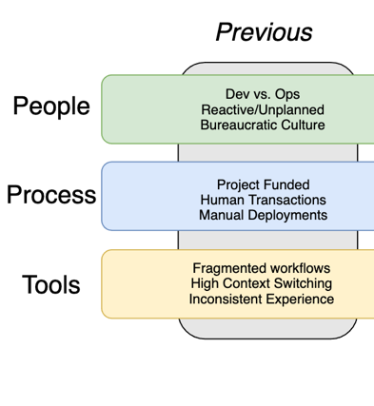
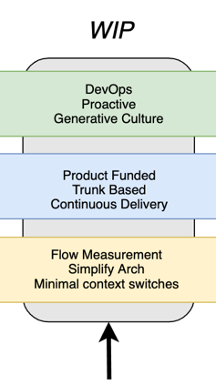
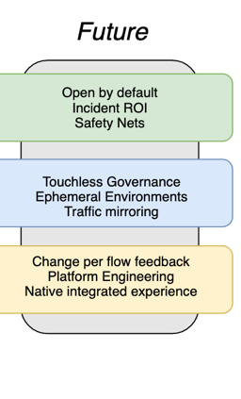
T-MOBILE TRANSFORMATION UPDATE
Notes:
Funding
Ways of working
Platforms
Services
Continuous Improvement
Part of transformation is strategically thinking about what comes next for your products, investments, and your workforce.
”What is the long term benefit of transforming a contingent workforce” – you could look at it like we’re literally building the assets of other companies.
How does the people transition to Jennifer’s goals?
How can this transition to process and tools?
Journey funding – ECOB – Enterprise commissions operations board, decide every week what the most important next change is for commissions. Team went Kanban and flipped the meeting into prioritization sessions.

Slide 33
HOW TO SOLVE
Bring dev in-house
Restructure recruiting
Uncarrier interview
Product oriented
Autonomy from the beginning (choice)
Onboarding
Expectations
Notes:
Jen Slide
What does it mean to be proud of where you work?
Learn how to speak to developers on what was important to them:
Disconnected experience between front door and back room.
Be a part of part of continuous improvement
Learning Day, Gitlab, Idea box, inner source/open source, DE&I in various groups that add to how they connect. Our developers are building how to build candidates.
Development the place where the work gets done. Coming in to make T-Mobile the better place. That changes in moving in the positive direction. Product/5G corporate strategies. What T-Mobile’s purpose is in the development space.
Why is setting expectations from the beginning such an important thing?
Ok, so now we’ve hired a bunch of people who are good at software – what next?
How does their experience match their expectation?

Slide 34
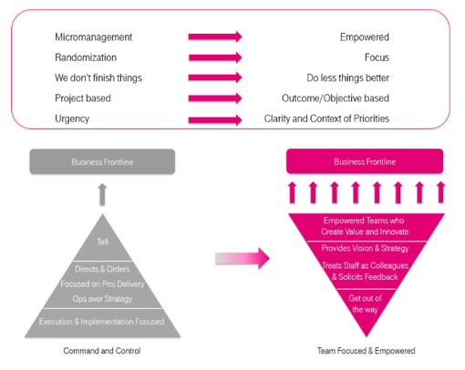
IMPACT PICTURE
Notes:
Jen Slide
Competing with each other.
Princple Arch rec open – we’re fighting over the same person… Workforce has lined everything up with a different means for prioritization… I had the person on the hook, but I wanted them more and needed them more – are we are or not on the same team?

